Slide 1
Improving GPipe Partitioning
吳倉永、林其昌、錢柏均
Professor Chia-Lin Yang

Slide 2
Outline
Project Introduction
Technical Requirements
Timeline Profiling
Dynamic-Programming Partitioning
Throughput Estimation
Notes:
This is our outline
First, we’ll introduce what our project goals, motivation and solution, which is our proposed method about the problem
Second, in we we’ll go through details of our methods

Slide 3
Outline
Experiments
Comparison with other Methods
Load Balancing
Conclusion
Future Work
References
Notes:
Later, in experiments, we compare our proposed method and previous ones, with charts and provide some observation
in conclusion, we’ll summarize our works, and discuss about future work of our proposed method

Slide 4
Project Introduction
Notes:
Introduction to our project
Our goal
Motivation
Proposed methods
And briefly introduce Our project workflow

Slide 5
Goal
Facilitate GPipe parallel training process of giant neural networks to get better training throughput
Notes:
Our goal is to facilitate the parallel training process of a giant neural networks
And as we know Gpipe is currently working on it.

Slide 6
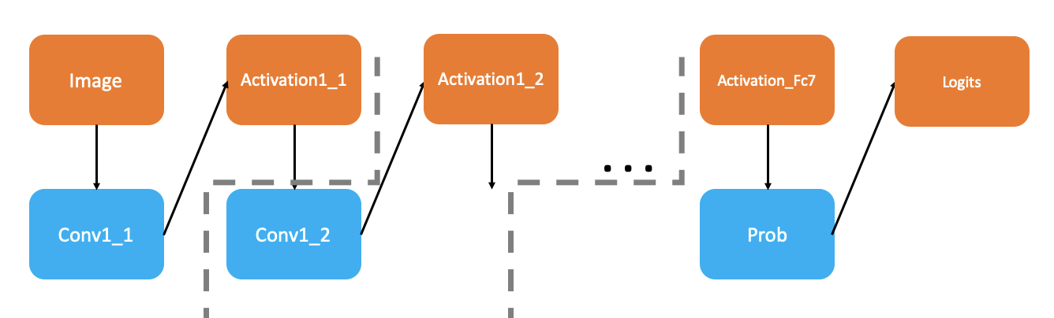
Motivation
GPipe heuristic-based partitioning algorithm
Notes:
And as we know Gpipe is currently working on it.
We now don’t know whether Gpipe’s partitioning is good or not

Slide 7

Motivation
GPipe heuristic-based partitioning algorithm
Notes:
And as we know Gpipe is currently working on it.
We now don’t know whether Gpipe’s partitioning is good or not

Slide 8
Motivation
GPipe heuristic-based partitioning algorithm
Imbalanced partition results in waiting time for next batch
Notes:
and we know, the partitioning overhead would increase as GPUs number increased, and become a cost for computation

Slide 9
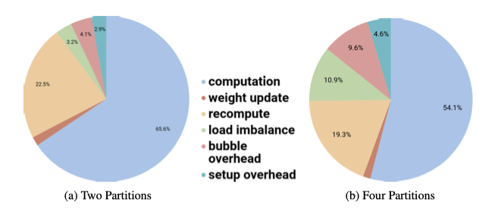
Motivation
GPipe heuristic-based partitioning algorithm
Imbalanced partition results in waiting time for next batch
2 machines -> 4 machines
Overhead 3.2% -> 10.9%
Notes:
and we know, the partitioning overhead would increase as GPUs number increased, and become a cost for computation

Slide 10
Proposed Solution – Black GPipe
Facilitate GPipe parallel training process of giant neural networks to get better training throughput
Notes:
So, we proposed a solution that want to incorporate GPipe methodologies and PipeDream methodologies

Slide 11
Proposed Solution – Black GPipe
Facilitate GPipe parallel training process of giant neural networks to get better training throughput

Slide 12
Proposed Solution – Black GPipe
Facilitate GPipe parallel training process of giant neural networks to get better training throughput
+
PipeDream
=

Slide 13
Proposed Solution – Black GPipe
Facilitate GPipe parallel training process of giant neural networks to get better training throughput
+
PipeDream
=

Slide 14
Proposed Solution – Black GPipe
Facilitate GPipe parallel training process of giant neural networks to get better training throughput
To see if we can beat DP and Naïve GPipe on throughput
+
PipeDream
=
Notes:
To see if our method is better than DP-only and Naïve Gpipe partitioning on through put

Slide 15
GPipe Micro-batch Recap
Notes:
Let’s recap what Gpipe micro-batch is

Slide 16
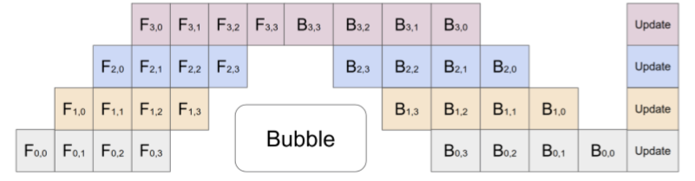
GPipe Micro-batch Recap
Split mini-batch into several micro-batches
Notes:
Let’s recap what Gpipe micro-batch is

Slide 17
GPipe Micro-batch Recap
We need time information for a micro-batch to estimate training time
Execution time & Communication time

Slide 18
Black GPipe Workflow
Notes:
What is parallel training?
The answer is quite intuitive, we distribute the neural network training computation among multiple GPUs,
and execute each partition in parallel.

Slide 19
Black GPipe Workflow
Specify number of machines and number of micro-batches
Micro-batch size = Batch size / Number of micro-batches
Notes:
We need micro-batch size, and profile using this time information of this batch size, and

Slide 20
Black GPipe Workflow
Specify number of machines and number of micro-batches
Micro-batch size = Batch size / Number of micro-batches
Profile Resnet-152 and VGG19 to get time information w.r.t the micro-batch size
Notes:
We use Resnet-152 and VGG19 and get each layer‘s time information including execution time and communication time

Slide 21
Black GPipe Workflow
Specify number of machines and number of micro-batches
Micro-batch size = Batch size / Number of micro-batches
Profile Resnet-152 and VGG19 to get time information w.r.t the micro-batch size
Use our algorithm to determine partition scheme (DP + MP)
Notes:
Obtain data parallelism and model parallelism

Slide 22
Black GPipe Workflow
Specify number of machines and number of micro-batches
Micro-batch size = Batch size / Number of micro-batches
Profile Resnet-152 and VGG19 to get time information w.r.t the micro-batch size
Use our algorithm to determine partition scheme (DP + MP)
For each stages, obtain its execution time and get the throughput of the model by estimation
Including backward and forward pass
Moreover in backward we implement re-computation
Notes:
So we will get partitions outcome, different stages, and get the time and estimate the model throughput
So, we will get into each parts of the steps in details

Slide 23
Timeline Profiling
Dynamic-Programming Partitioning
Throughput Estimation
Notes:
Let’s introduce how we implement profiling

Slide 24
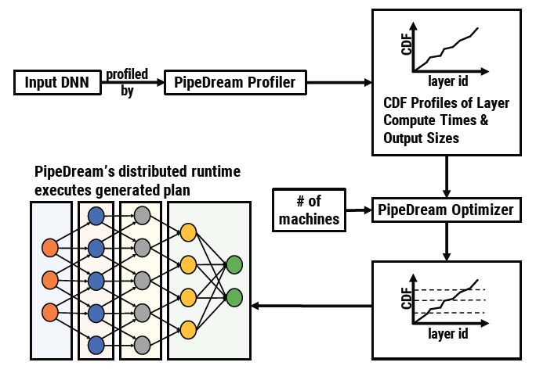
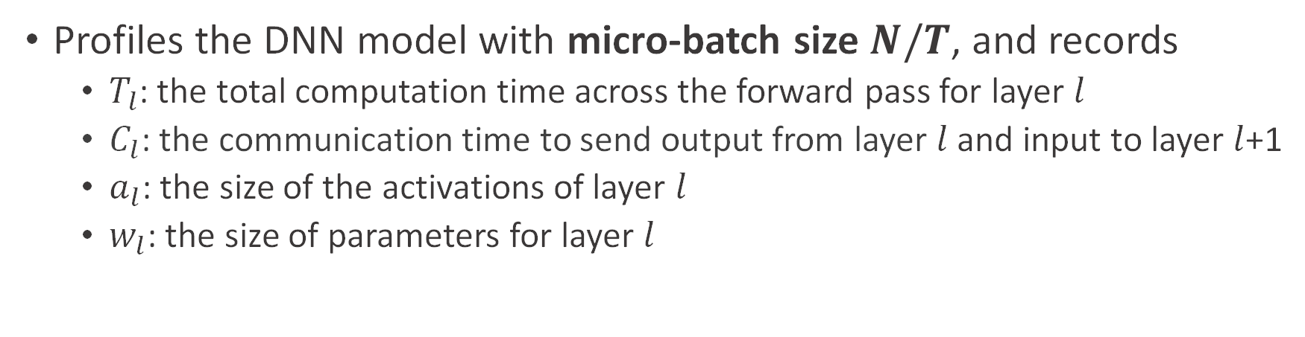
What to Get?
Profiles the DNN model with micro-batch size $N/T$, and records
$T_{l}$: the total computation time across the forward pass for layer $l$
$C_{l}$: the communication time to send output from layer $l$ and input to layer $l$+1
$a_{l}$: the size of the activations of layer $l$
$w_{l}$: the size of parameters for layer $l$
Fig. referred from [4].
Notes:
We need this parameters
Details go through
Tl:
Cl
Al
wl

Slide 25
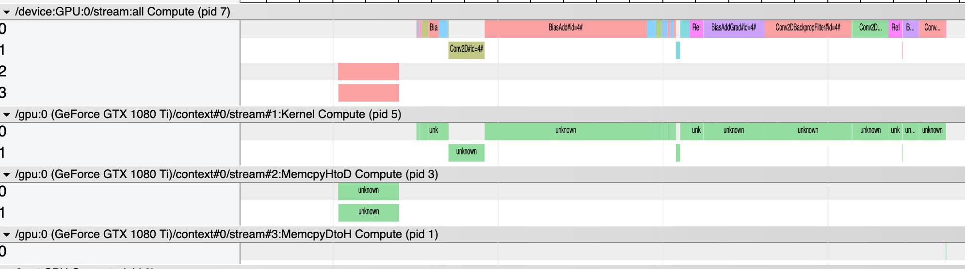
How We Get?
TensorFlow Timeline Object
Notes:
We use tensorflow timeline object

Slide 26
How We Get?
TensorFlow Timeline Object
Notes:
Means the GPU computation information

Slide 27
How We Get?
TensorFlow Timeline Object
Total GPU Computation Time
Notes:
Get total GPU computation time

Slide 28
How We Get?
TensorFlow Timeline Object
Total GPU Computation Time
Notes:
Memory copy time from CPU to GPU (host to device)
We can get related information from this section

Slide 29
How We Get?
TensorFlow Timeline Object
Total GPU Computation Time
Total Input Communication Time:
from CPU to GPU
Notes:
So it means input communication time

Slide 30
How We Get?
TensorFlow Timeline Object
Total GPU Computation Time
Total Input Communication Time:
from CPU to GPU
Notes:
And GPU to CPU (DtoH)
Output communication time

Slide 31
How We Get?
TensorFlow Timeline Object
Total GPU Computation Time
Total Input Communication Time:
from CPU to GPU
Total Output Communication Time :
from GPU to CPU

Slide 32
Why We Need This
Image
Notes:
So, lets see why we need this

Slide 33
Let’s Look at A Model
Assume no inter-connection between GPU
Data Communication need to send between CPU and GPU
Image
Notes:
if GPU wants to communicate with each other

Slide 34
Let’s Look at A Model
Assume no inter-connection between GPU
Data Communication need to send between CPU and GPU
Image
CPU
GPU

Slide 35
Let’s Look at A Model
Image
CPU
GPU
Conv1_1

Slide 36
Let’s Look at A Model
Image
Activation1_1
CPU
GPU
Conv1_1

Slide 37
Let’s Look at A Model
Image
Activation1_1
CPU
GPU
Conv1_1
Conv1_2

Slide 38
Let’s Look at A Model
Image
Activation1_1
Activation1_2
CPU
GPU
Conv1_1
Conv1_2

Slide 39
Let’s Look at A Model
Image
Activation1_1
Activation1_2
. . .
CPU
GPU
Conv1_1
Conv1_2

Slide 40
Let’s Look at A Model
Image
Activation1_1
Activation1_2
Activation_Fc7
Logits
. . .
CPU
GPU
Conv1_1
Conv1_2
Prob

Slide 41
What We Want
We need each layer’s communication time which are
the time to send activations from GPU to CPU w.r.t current layer
and time to send these activations from CPU back to GPU w.r.t next layer
Image
Activation1_1
Activation1_2
Activation_Fc7
Logits
. . .
CPU
GPU
Conv1_1
Conv1_2
Prob

Slide 42
What We Want
Since we want to find a split point to split model into stages
We need this communication time to determine the cost of this split point
Image
Activation1_1
Activation1_2
Activation_Fc7
Logits
. . .
CPU
GPU
Conv1_1
Conv1_2
Prob

Slide 43
Split Model into Stages
Image
Activation1_1
Activation1_2
Activation_Fc7
Logits
. . .
CPU
GPU
Conv1_1
Conv1_2
Prob

Slide 44
Split Model into Stages
We have 3 machines computing this model
Image
Activation1_1
Activation1_2
Activation_Fc7
Logits
. . .
CPU
GPU
Conv1_1
Conv1_2
Prob
Machine 1
Machine 2
Machine 3

Slide 45
Dataflow Explain
Input image communication (ignore this operation cost)
Image
Activation1_1
Activation1_2
Activation_Fc7
Logits
. . .
CPU
GPU
Conv1_1
Conv1_2
Prob
Machine 1
Machine 2
Machine 3

Slide 46
Dataflow Explain
Image
Activation1_1
Activation1_2
Activation_Fc7
Logits
. . .
CPU
GPU
Conv1_1
Conv1_2
Prob
Machine 1
Machine 2
Machine 3

Slide 47
Dataflow Explain
Layer Conv1_1 computation time
Image
Activation1_1
Activation1_2
Activation_Fc7
Logits
. . .
CPU
GPU
Conv1_1
Conv1_2
Prob
GPU Computation
Machine 1
Machine 2
Machine 3

Slide 48
Dataflow Explain
Image
Activation1_1
Activation1_2
Activation_Fc7
Logits
. . .
CPU
GPU
Conv1_1
Conv1_2
Prob
GPU Computation
Machine 1
Machine 2
Machine 3

Slide 49
Dataflow Explain
Output activation of layer Conv1_1 communication time
Image
Activation1_1
Activation1_2
Activation_Fc7
Logits
Output
Communication
. . .
CPU
GPU
Conv1_1
Conv1_2
Prob
GPU Computation
Machine 1
Machine 2
Machine 3

Slide 50
Dataflow Explain
Output activation of layer Conv1_1 communication time
Image
Activation1_1
Activation1_2
Activation_Fc7
Logits
Output
Communication
. . .
CPU
GPU
Conv1_1
Conv1_2
Prob
GPU Computation
Machine 1
Machine 2
Machine 3

Slide 51
Dataflow Explain
Output activation of layer Conv1_1 communication time
Input activation of next layer Conv1_2 communication time
Image
Activation1_1
Activation1_2
Activation_Fc7
Logits
Output
Communication
. . .
CPU
Input
Communication
GPU
Conv1_1
Conv1_2
Prob
GPU Computation
Machine 1
Machine 2
Machine 3

Slide 52
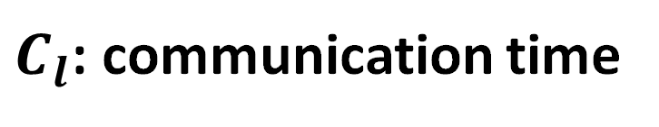
Dataflow Explain
Output activation of layer Conv1_1 communication time
Input activation of next layer Conv1_2 communication time
Image
Activation1_1
Activation1_2
Activation_Fc7
Logits
$C_{l}$: communication time
Output
Communication
+
. . .
CPU
Input
Communication
GPU
Conv1_1
Conv1_2
Prob
GPU Computation
Machine 1
Machine 2
Machine 3

Slide 53
Dataflow Explain
Image
Activation1_1
Activation1_2
Activation_Fc7
Logits
$C_{l}$: communication time
Output
Communication
+
. . .
CPU
Input
Communication
GPU
Conv1_1
Conv1_2
Prob
GPU Computation
Machine 1
Machine 2
Machine 3

Slide 54
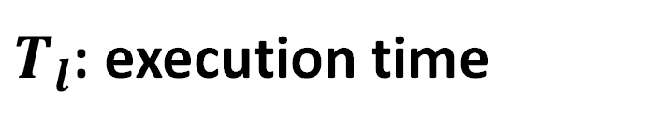
Dataflow Explain
Image
Activation1_1
Activation1_2
Activation_Fc7
Logits
$C_{l}$: communication time
Output
Communication
+
. . .
CPU
Input
Communication
GPU
Conv1_1
Conv1_2
Prob
$T_{l}$: execution time
GPU Computation
Machine 1
Machine 2
Machine 3

Slide 55
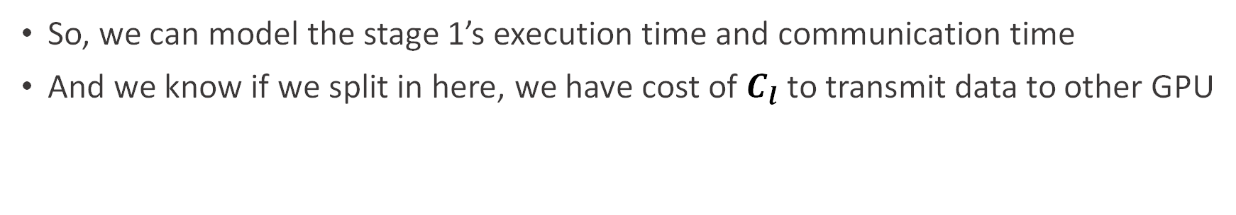
Dataflow Explain
So, we can model the stage 1’s execution time and communication time
And we know if we split in here, we have cost of $C_{l}$ to transmit data to other GPU
Image
Activation1_1
Activation1_2
Activation_Fc7
Logits
$C_{l}$: communication time
Output
Communication
+
. . .
CPU
Input
Communication
GPU
Conv1_1
Conv1_2
Prob
$T_{l}$: execution time
GPU Computation
Machine 1
Machine 2
Machine 3

Slide 56
Dataflow Explain
Image
Activation1_1
Activation1_2
Activation_Fc7
Logits
. . .
CPU
GPU
Conv1_1
Conv1_2
Prob
Machine 1
Machine 2
Machine 3

Slide 57
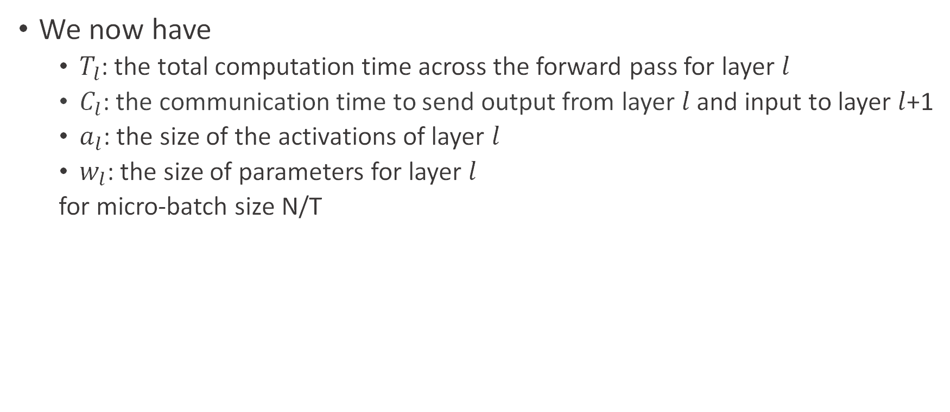
Move On to Partitioning
We now have
$T_{l}$: the total computation time across the forward pass for layer $l$
$C_{l}$: the communication time to send output from layer $l$ and input to layer $l$+1
$a_{l}$: the size of the activations of layer $l$
$w_{l}$: the size of parameters for layer $l$
for micro-batch size N/T

Slide 58
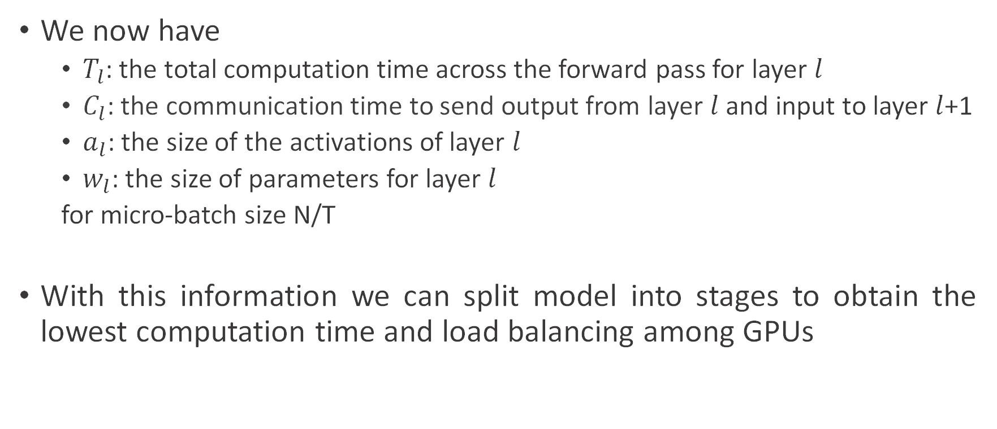
Move On to Partitioning
We now have
$T_{l}$: the total computation time across the forward pass for layer $l$
$C_{l}$: the communication time to send output from layer $l$ and input to layer $l$+1
$a_{l}$: the size of the activations of layer $l$
$w_{l}$: the size of parameters for layer $l$
for micro-batch size N/T
With this information we can split model into stages to obtain the lowest computation time and load balancing among GPUs

Slide 59
Timeline Profiling
Dynamic-Programming Partitioning
Throughput Estimation

Slide 60
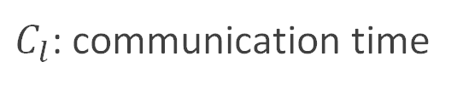
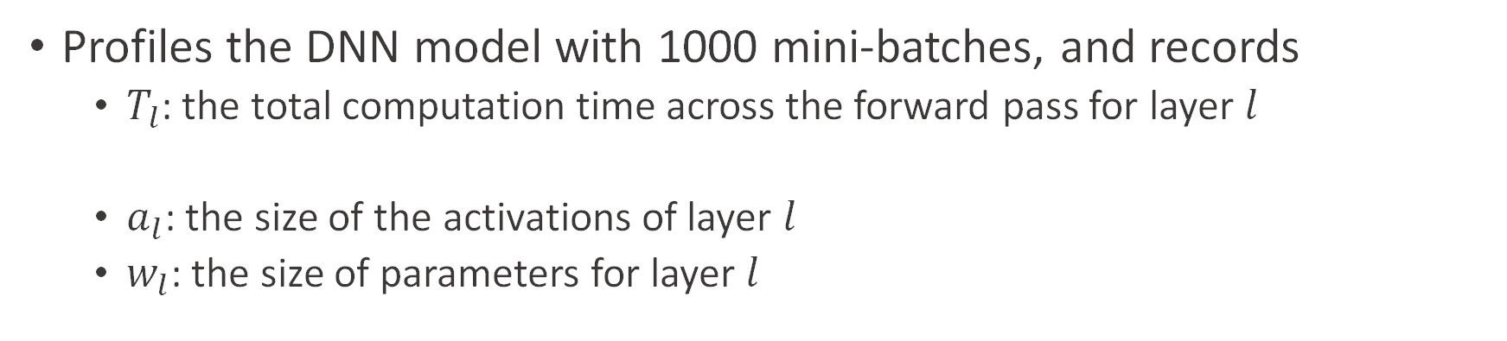
Profiling
Profiles the DNN model with 1000 mini-batches, and records
$T_{l}$: the total computation time across the forward pass for layer $l$
$a_{l}$: the size of the activations of layer $l$
$w_{l}$: the size of parameters for layer $l$
$C_{l}$: communication time
Fig. taken from [4].
Notes:
In order to get a good partition of a model.
They profile the computation and estimate the communication time of each layer of the DNN model with 1000 mini-batches.
So we do the similar things except that we also profile the communication time instead of estimated from other parameters.

Slide 61
Profiling
Profiles the DNN model with micro-batch size $N/T$, and records
$T_{l}$: the total computation time across the forward pass for layer $l$
$C_{l}$: the communication time to send output from layer $l$ and input to layer $l$+1
$a_{l}$: the size of the activations of layer $l$
$w_{l}$: the size of parameters for layer $l$
Fig. referred from [4].

Slide 62
Partitioning
(Best partition if possible)
75%
50%
25%
Fig. taken from [4].
Notes:
The overall flow is shown is this figure.
What we want is a balance partition that minimize the pipeline bottleneck stage cost.
For example if this is the cumulative distribution of the time cost, and we have four accelerators now.
We would anticipate a partition such that each of the four stage take 25% of the total time
so that when the pipeline is full, or what we call the steady state, there will be no worker idling at any time.

Slide 63
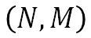
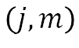
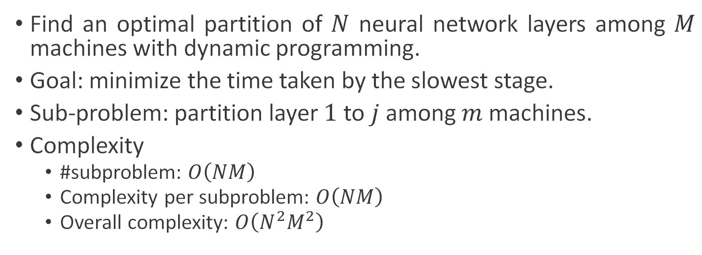
Partitioning
Find an optimal partition of $N$ neural network layers among $M$ machines with dynamic programming.
Goal: minimize the time taken by the slowest stage.
Sub-problem: partition layer $1$ to $j$ among $m$ machines.
Complexity
#subproblem: $O\left(NM\right)$
Complexity per subproblem: $O\left(NM\right)$
Overall complexity: $O\left(N^{2}M^{2}\right)$
$$\left(N, M\right)$$
$$\left(j, m\right)$$
Notes:
With the profiled statistics, we can obtain an optimal partition by dynamic programming.
The problem is formulated as follows:
Suppose there are N layers and M machines, the goal of the algorithm is to minimize the time taken by the slowest stage.
The sub-problem of the dynamic programming is defined as partitioning layer $1$ to $j$ among $m$ machines,
and we take advantage of the optimal substructure property to solve the original problem.
It is straightforward to show that this is a polynomial-time algorithm.

Slide 64
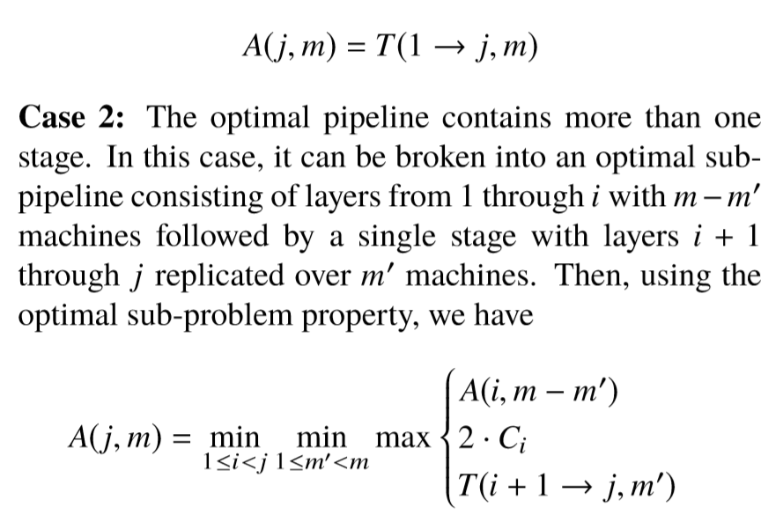
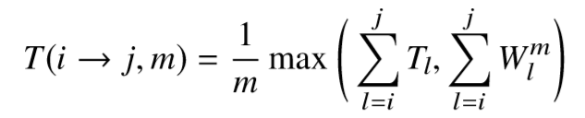
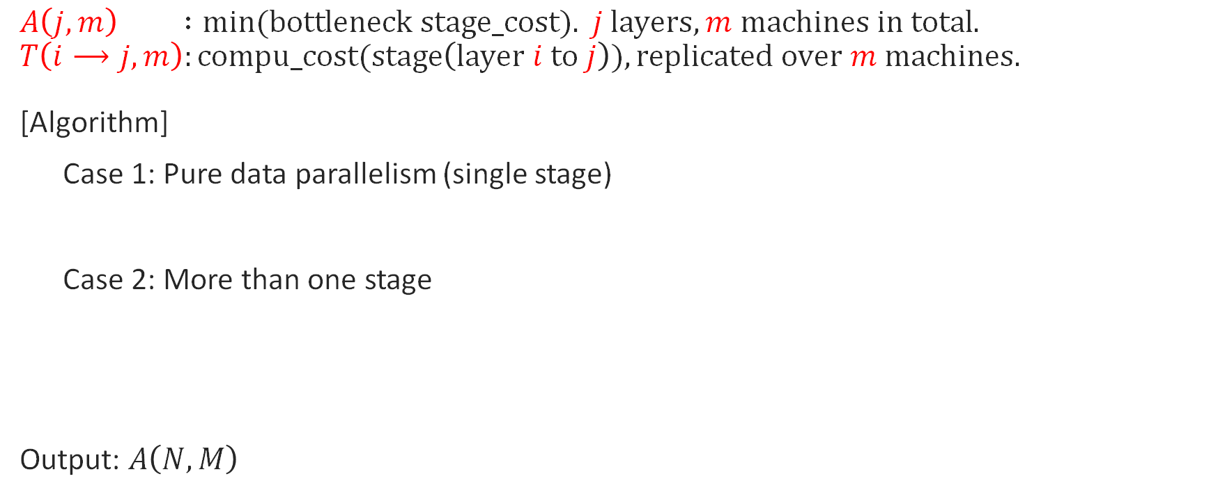
Partitioning Algorithm with DP
$$A\left(j,m\right) :min(bottleneck stage_cost). j layers, m machines in total.$$
$$T\left(i⟶j,m\right):compu_cost(stage\left(layer i to j\right)), replicated over m machines.$$
[Algorithm]
Case 1: Pure data parallelism (single stage)
Case 2: More than one stage
Output: $A\left(N,M\right)$
What we have:
$C_{l}$: communication cost from layer i to i+1
$W_{l}^{m}$: weight update cost for layer i
Notes:
This is the formal version.
A is the bottleneck cost we want to minimize, and T is the stage cost where the stage spans from layer i to j and is replicated over machines.
T can be estimated by the profiling result, and then A is determined by this recursive relation.
It says that for each possible solution determined by i and m’, the bottleneck cost would be among these three terms:
the last stage cost, the communication cost from the second last stage to the last stage, and the sub-problem bottleneck.
And then this recursive relation pick the minimal bottleneck among all possible solutions.
This is the partition algorithm of PipeDream.

Slide 65
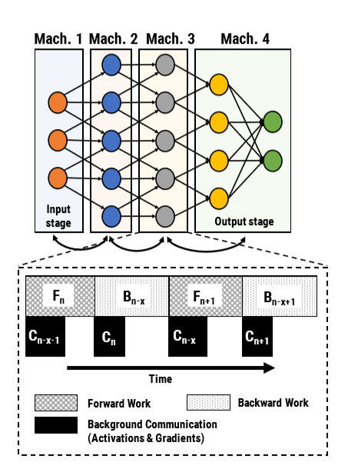
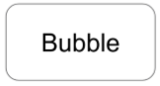
Pipelining in PipeDream vs. in GPipe
PipeDream
GPipe
$$F_{1}$$ | $$F_{2}$$ | $$F_{3}$$ | $$F_{4}$$ | $$F_{5}$$ | $$F_{6}$$ | $$F_{7}$$ | $$F_{8}$$
$$F_{1}$$ | $$F_{2}$$ | $$F_{3}$$ | $$F_{4}$$ | $$F_{5}$$ | $$F_{6}$$ | $$F_{7}$$ | $$F_{8}$$
$$F_{1}$$ | $$F_{2}$$ | $$F_{3}$$ | $$F_{4}$$ | $$F_{5}$$ | $$F_{6}$$ | $$F_{7}$$ | $$F_{8}$$
$$F_{1}$$ | $$F_{2}$$ | $$F_{3}$$ | $$F_{4}$$ | $$F_{5}$$ | $$F_{6}$$ | $$F_{7}$$ | $$F_{8}$$
Hide communication latency by overlapping
communication and computation of different mini-batch
$$C_{1}$$ | $$C_{2}$$ | $$C_{3}$$ | $$C_{4}$$ | $$C_{5}$$ | $$C_{6}$$ | $$C_{7}$$ | $$C_{8}$$
Notes:
So what we need to do now is to find a suitable partition algorithm for Gpipe.
Inspired by the configuration of PipeDream to hide the communication latency by overlapping it with computation,
we make a little adjustment to the configuration of Gpipe.
Here one micro-batch in Gpipe is analogous to one forward-backward pair formulated in PipeDream.
In other words, we further split one micro-batch into two. …
Since both are implemented in a pipelining mechanism, we find the two configurations essentially very similar if we separate the concept of batch and treat all data as the same, and if we neglect the turning point in Gpipe.
So, we believe the recursive relation adopted by PipeDream can be applied to Gpipe too, except that some slight changes are necessary.
Another advantage is that with this algorithm solutions with data parallelism will be taken into account.
The original Gpipe has only model parallelism.

Slide 66
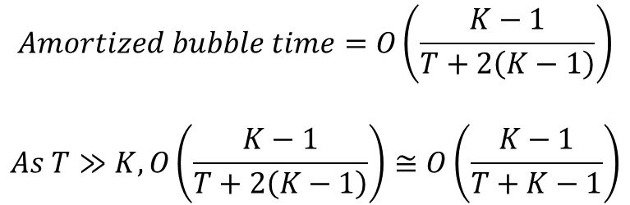
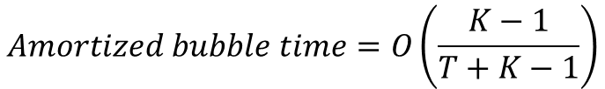
Same Order of Amortized Bubble Time
GPipe
T = # of micro-batches K = # of stages
$$Amortized bubble time=O\left(\frac{K−1}{T+K−1}\right)$$
$$Amortized bubble time=O\left(\frac{K−1}{T+2\left(K−1\right)}\right)$$
$$As T≫K, O\left(\frac{K−1}{T+2\left(K−1\right)}\right)≅O\left(\frac{K−1}{T+K−1}\right)$$
$$F_{1}$$ | $$F_{2}$$ | $$F_{3}$$ | $$F_{4}$$ | $$F_{5}$$ | $$F_{6}$$ | $$F_{7}$$ | $$F_{8}$$
$$F_{1}$$ | $$F_{2}$$ | $$F_{3}$$ | $$F_{4}$$ | $$F_{5}$$ | $$F_{6}$$ | $$F_{7}$$ | $$F_{8}$$
$$F_{1}$$ | $$F_{2}$$ | $$F_{3}$$ | $$F_{4}$$ | $$F_{5}$$ | $$F_{6}$$ | $$F_{7}$$ | $$F_{8}$$
$$F_{1}$$ | $$F_{2}$$ | $$F_{3}$$ | $$F_{4}$$ | $$F_{5}$$ | $$F_{6}$$ | $$F_{7}$$ | $$F_{8}$$
$$C_{1}$$ | $$C_{2}$$ | $$C_{3}$$ | $$C_{4}$$ | $$C_{5}$$ | $$C_{6}$$ | $$C_{7}$$ | $$C_{8}$$
Notes:
Before customizing our algorithm, we have to make sure if such configuration violates Gpipe’s properties or goals or gives up their original advantages.
We find that most of them remains the same. The only thing I‘d like to note is the amortized bubble time.
With some analysis, we conclude that it is of the same order as the original.
They are only different by a factor of constant 2, and this factor would even disappear if we separate each mini-batch into more and more micro-batch.

Slide 67
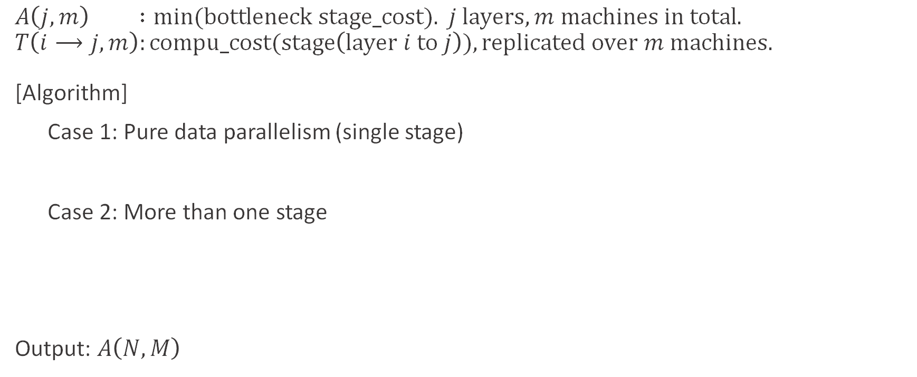
Customized Partitioning Algorithm
$$A\left(j,m\right) :min(bottleneck stage_cost). j layers, m machines in total.$$
$$T\left(i⟶j,m\right):compu_cost(stage\left(layer i to j\right)), replicated over m machines.$$
[Algorithm]
Case 1: Pure data parallelism (single stage)
Case 2: More than one stage
Output: $A\left(N,M\right)$
What we have:
3. if …
$C_{l}$: communication cost from layer i to i+1
1.
$W_{l}^{m}$: weight update cost for layer i
2.
3. if …
Notes:
Let’s next consider three potential changes we may need to make to the algorithm.
The term related to weight update can be omitted.
We need to customize our communication time estimator.
And we need additional constraints for the recursive relation.

Slide 68
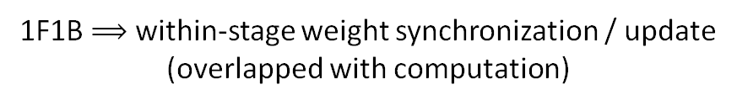
1. No Within-Stage Weight Synchronization
PipeDream
GPipe
1F1B $⟹$ within-stage weight synchronization / update
(overlapped with computation)
Weight synchronization / update is performed
at the end of each mini-batch
Notes:
First of all, in PipeDream forward and backward computation are interleaved, and in this way the weight should be synchronized during the pipelining.
Therefore, for each possible stage, the stage cost is formulated as such:
We have two statistics: sum of computation time and sum of weight synchronizing time.
Since they are overlapped, the larger one is the estimated cost of the stage.
However, in Gpipe the weight synchronization is postponed to the end of each mini-batch as shown, no need to consider the weight synchronize time.
The cost estimation becomes simpler. This is what happens within a stage.

Slide 69
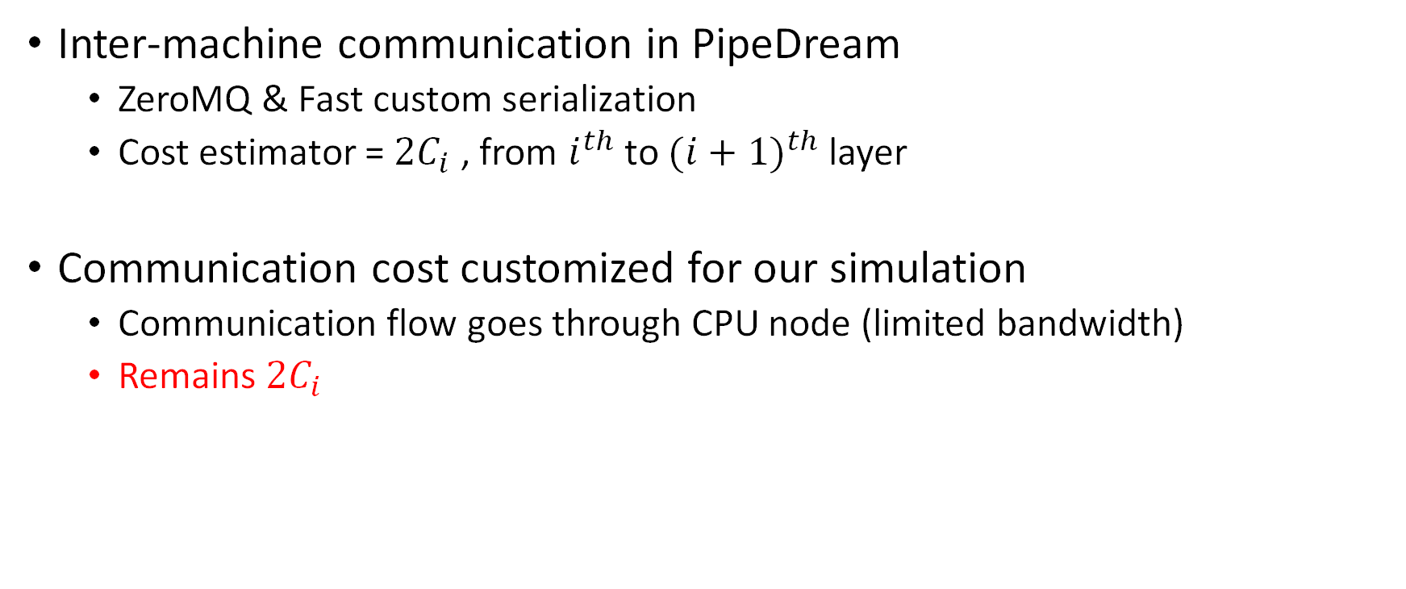
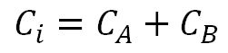
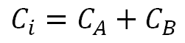
2. Communication Cost Estimator
Inter-machine communication in PipeDream
ZeroMQ & Fast custom serialization
Cost estimator = ${2C}_{i}$ , from $i^{th}$ to ${(i+1)}^{th}$ layer
Communication cost customized for our simulation
Communication flow goes through CPU node (limited bandwidth)
Remains ${2C}_{i}$
CPU
GPU
Data parallelism
$${\frac{1}{3}C}_{A}$$
$${\frac{1}{2}C}_{B}$$
$$C_{A}$$
$$C_{B}$$
Layer i
Layer i+1
Layer i
Layer i+1
$$C_{i}=C_{A}+C_{B}$$
$$C_{i}=C_{A}+C_{B}$$
Notes:
What happens across the stage is the communication of output activations and input gradients.
Here we need to say something about the communication cost, because our environmental setting has a fundamental difference from that used by PipeDream team.
Our data exchange among GPU accelerators is done with a central CPU.
We reconsider what should be our communication cost estimators.
/**/
We conclude that our estimator is the same as before, 2 times the layer communication cost.
(We skip the detail why this is multiplied by 2.)

Slide 70
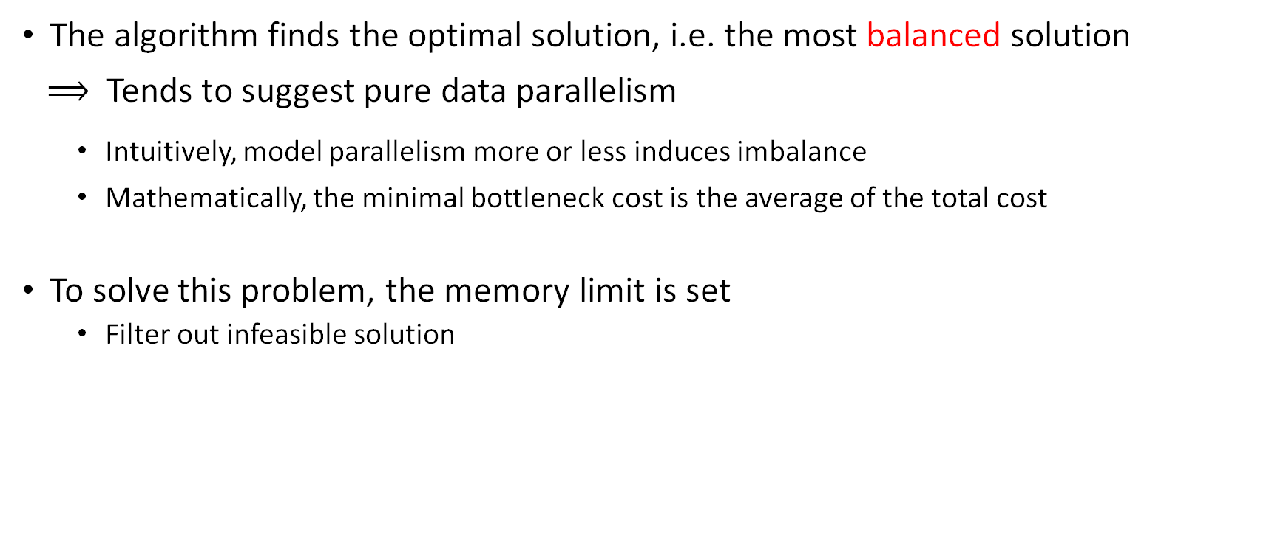
3. Upper Bound of Device Memory Usage
The algorithm finds the optimal solution, i.e. the most balanced solution
$⟹$ Tends to suggest pure data parallelism
Intuitively, model parallelism more or less induces imbalance
Mathematically, the minimal bottleneck cost is the average of the total cost
To solve this problem, the memory limit is set
Filter out infeasible solution
$$L\left(i,j\right)=memory usage for layer i to j$$
$$if L\left(1⟶j\right)<Memory Limit$$
$$if L\left(i+1⟶j\right)<Memory Limit$$
Notes:
There is still one important thing I’d like to mention.
Although DP gives the optimal solution, it tends to suggest pure data parallelism.
This phenomenon can be explained intuitively and mathematically.
The intuition is that the algorithm finds the minimum possible bottleneck, but the model parallelism certainly and inevitably bring imbalance to some extent.
To give a mathematical explanation, this is because the minimum possible bottleneck must be the average, and our model takes the average if data parallelism is used.
But why we need model parallelism in addition to data parallelism? Because the model is simply too large to fit into a single accelerator!
Therefore, to solve this problem, we specify the upper bound of the device memory usage as an extra constraints.
In this way we get rid of the impossible solutions.

Slide 71
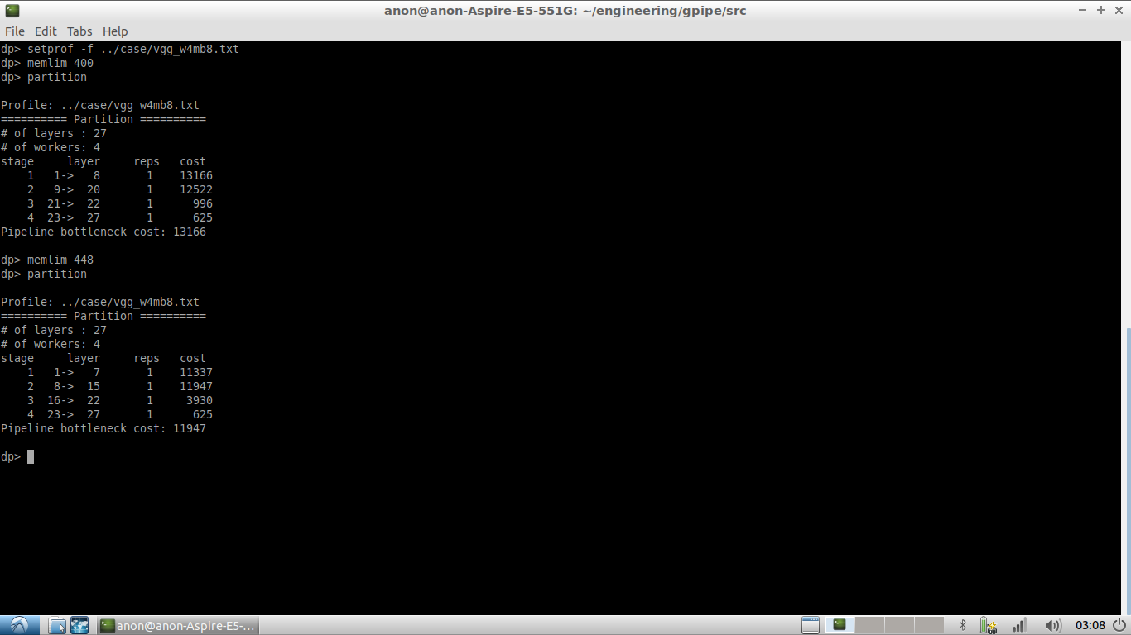
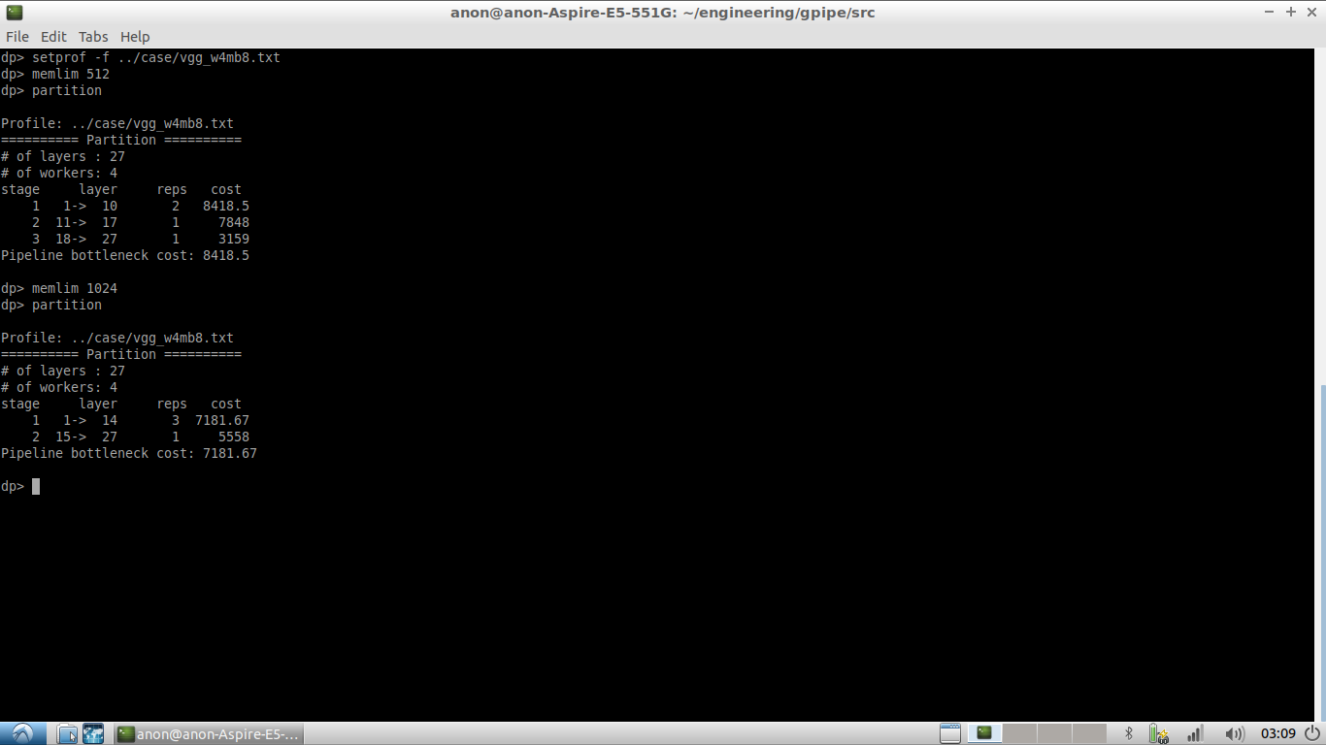
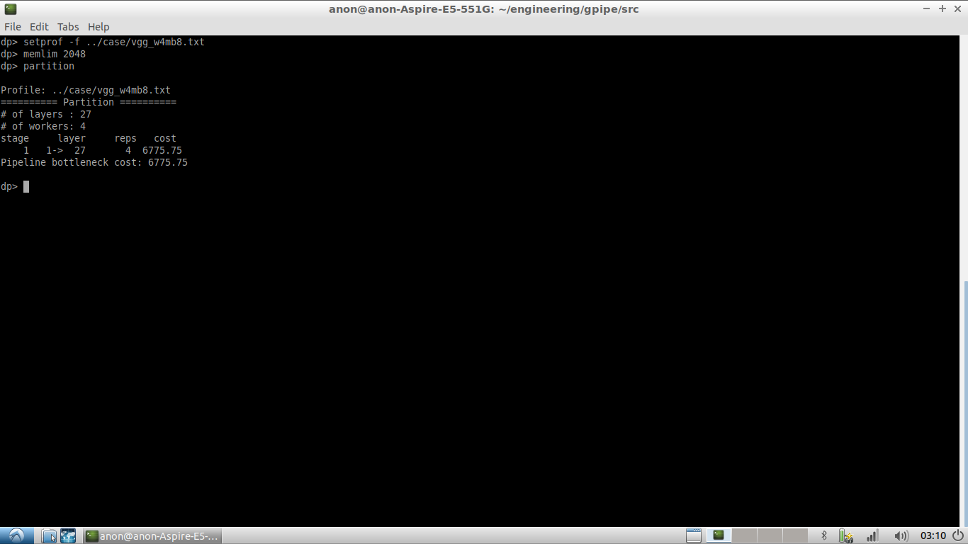
Example of Partitioning Solutions
Memory Limit (MB) | Partition | Bottleneck cost
400 | 1->8 9->20 21->22 23->27 | 13166
448 | 1->7 8->15 16->22 23->27 | 11947
512 | 1->10 11->17 18->27 | 8419
1024 | 1->14 15->27 | 7182
2048 | 1->27 | 6776
Model: VGG. Profiled with a fixed batch size.
# of layers = 27
# of machines = 4
Notes:
Based on the description we develop a partitioner core,
which takes in the forward pass profiling result and the configuration such as #layers and #machines, and output the optimal partitioning solution.
This is a simple example for partitioning the Vgg with 27 layers among 4 accelerators.
Since DP always suggest the optimal solution of the problem, the quality of our problem model directly determines the quality of the partitioning solution.

Slide 72
Timeline Profiling
Dynamic-Programming Partitioning
Throughput Estimation
Notes:
In the following section, I will introduce our approach to estimate the training cycle time and the throughput of our partitioning.
Since we don’t have access to multi-GPUs servers, we figure out a way to estimate runtime reasonably on a single GPU environment.

Slide 73
Model Partitioning
With the obtained partition from previous steps…
Stage 0
Stage 1
Stage 2
Stage 3
GPU1
GPU4
GPU0
GPU2
GPU6
GPU5
GPU3
Notes:
From the previous step, we can obtain a model partition.
In this example, there are 7 GPUs and the model is split into 4 stages.
Each stage contains multiple layers.

Slide 74
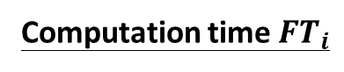

Forward Pass
micro-batch
input activations
micro-batch
output activations
CPU
GPU
Computation time ${FT}_{i}$
…
Communication time ${FC}_{i}$
Multiple layers
Stage i
Stage i+1
Notes:
To measure the time needed in the forward pass of a single stage.
We first build the sub-model of this stage.
Then we feed in the micro-batch of the activations from the previous stage.
With tensorflow timeline we can retrieve the computation time FTi of this stage.
And the communication time FCi of this layer is defined as the time required the pass the output activations to the next stage, which can also be retrieved by timeline as well.
We measure them repeatedly and get an average value.

Slide 75
Backward Pass
activations
of stage i-1
forward re-computation
gradients
of stage i+1
gradients
of stage i
back propagation
Stage i
Notes:
In the backward pass, we adopt forward re-computation as in GPipe.
However, to simply the problem, our checkpoint selection is quite naiive, we only store the forward activations at each cut point.
To compute the gradient, the required activations and gradients will be fed in,
then the forward re-computation will be performed,
Followed by the back propagation.

Slide 76
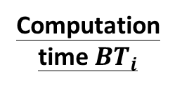
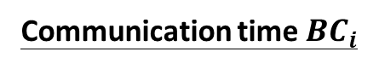
Backward Pass
activations
gradients
activations
gradients
CPU
Computation time ${BT}_{i}$
GPU
Communication time ${BC}_{i}$
Stage i-1
Stage i
Notes:
To measure the time needed in the backward pass of this stage.
The computation time is the time elapsed for both forward re-computation and back propagation.
And the communication time is the time required to pass the backward gradients and to send the activations to the previous stage.

Slide 77
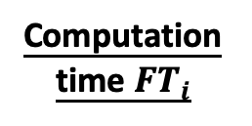
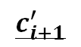
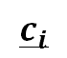
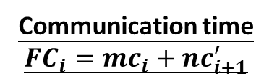
DP Time Estimation
Let micro-batch size be b
b/m activations
b/m activations
b/n activations
CPU
GPU
Computation time ${FT}_{i}$
$$c_{i}$$
$$c_{i+1}^{′}$$
Communication time ${FC}_{i}=mc_{i}+nc_{i+1}^{′}$
Stage i
(m machines)
Stage i+1
(n machines)
Notes:
There is one thing missing. How to estimate the time for data parallelism?
Take the forward pass for example.
Suppose the micro-batch size is b, we assign m machines to stage I and n machines to stage i+1
To measure the computation time, we will only feed in the nano-batch of data, whose size is b divided by m.
The communication time is calculated as follow,
ci is the time required to send b over m date from GPU to CPU
ci+1’ is the time required b oven n data from CPU to GPU.
Then FCi is m times ci plus n times ci+1’.
Similar for measuring time for the backward pass.

Slide 78
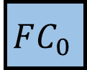
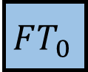
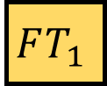
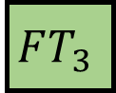
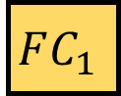
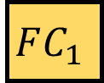
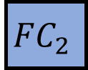
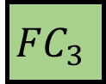


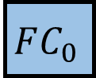
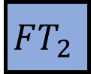




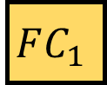
















































Pipelining
$${FC}_{3}$$
$${FC}_{3}$$
$${FC}_{3}$$
$${FC}_{3}$$
$${FC}_{3}$$
$${FC}_{3}$$
$${FC}_{3}$$
$${FC}_{3}$$
By taking $\max\left\{FT_{0}, FC_{0}, FT_{1}, FC_{1}\right\}$, we can obtain the time required for this time step.
$$FT_{3}$$
$$FT_{3}$$
$$FT_{3}$$
$$FT_{3}$$
$$FT_{3}$$
$$FT_{3}$$
$$FT_{3}$$
$$FT_{3}$$
$${FC}_{2}$$
$${FC}_{2}$$
$${FC}_{2}$$
$${FC}_{2}$$
$${FC}_{2}$$
$${FC}_{2}$$
$${FC}_{2}$$
$${FC}_{2}$$
$$FT_{2}$$
$$FT_{2}$$
$$FT_{2}$$
$$FT_{2}$$
$$FT_{2}$$
$$FT_{2}$$
$$FT_{2}$$
$$FT_{2}$$
$${FC}_{1}$$
$$FC_{1}$$
$$FC_{1}$$
$$FC_{1}$$
$$FC_{1}$$
$$FC_{1}$$
$$FC_{1}$$
$$FC_{1}$$
$$FT_{1}$$
$$FT_{1}$$
$$FT_{1}$$
$$FT_{1}$$
$$FT_{1}$$
$$FT_{1}$$
$$FT_{1}$$
$$FT_{1}$$
$$FC_{0}$$
$$FC_{0}$$
$$FC_{0}$$
$$FC_{0}$$
$$FC_{0}$$
$$FC_{0}$$
$$FC_{0}$$
$$FC_{0}$$
$$FT_{0}$$
$$FT_{0}$$
$$FT_{0}$$
$$FT_{0}$$
$$FT_{0}$$
$$FT_{0}$$
$$FT_{0}$$
$$FT_{0}$$
Notes:
With the measured data, we can stack them up to form the pipeline schedule.
For each time step we can get the time needed by simply taking the maximum value on that slice.
For example as shown in the figure, the time required for the forth time step is the maximum of the four values in the red block.

Slide 79



















Throughput Estimation
$${FC}_{3}$$
$${FC}_{3}$$
$${FC}_{3}$$
$${FC}_{3}$$
$${FC}_{3}$$
$${FC}_{3}$$
$${FC}_{3}$$
$${FC}_{3}$$
$${FC}_{3}$$
$${FC}_{3}$$
$${FC}_{3}$$
$${FC}_{3}$$
$${FC}_{3}$$
$${FC}_{3}$$
$${FC}_{3}$$
$$FT_{3}$$
$$FT_{3}$$
$$FT_{3}$$
$$FT_{3}$$
$$FT_{3}$$
$$FT_{3}$$
$$FT_{3}$$
$$FT_{3}$$
$$FT_{3}$$
$$FT_{3}$$
$$FT_{3}$$
$$FT_{3}$$
$$FT_{3}$$
$$FT_{3}$$
$$FT_{3}$$
$$FT_{3}$$
$${FC}_{2}$$
$${FC}_{2}$$
$${FC}_{2}$$
$${FC}_{2}$$
$${FC}_{2}$$
$${FC}_{2}$$
$${FC}_{2}$$
$${FC}_{2}$$
$${FC}_{2}$$
$${FC}_{2}$$
$${FC}_{2}$$
$${FC}_{2}$$
$${FC}_{2}$$
$${FC}_{2}$$
$${FC}_{2}$$
$${FC}_{2}$$
$$FT_{2}$$
$$FT_{2}$$
$$FT_{2}$$
$$FT_{2}$$
$$FT_{2}$$
$$FT_{2}$$
$$FT_{2}$$
$$FT_{2}$$
$$FT_{2}$$
$$FT_{2}$$
$$FT_{2}$$
$$FT_{2}$$
$$FT_{2}$$
$$FT_{2}$$
$$FT_{2}$$
$$FT_{2}$$
Weight update
& synchronization
$${FC}_{1}$$
$$FC_{1}$$
$$FC_{1}$$
$$FC_{1}$$
$$FC_{1}$$
$$FC_{1}$$
$$FC_{1}$$
$$FC_{1}$$
$${FC}_{1}$$
$$FC_{1}$$
$$FC_{1}$$
$$FC_{1}$$
$$FC_{1}$$
$$FC_{1}$$
$$FC_{1}$$
$$FC_{1}$$
$$FT_{1}$$
$$FT_{1}$$
$$FT_{1}$$
$$FT_{1}$$
$$FT_{1}$$
$$FT_{1}$$
$$FT_{1}$$
$$FT_{1}$$
$$FT_{1}$$
$$FT_{1}$$
$$FT_{1}$$
$$FT_{1}$$
$$FT_{1}$$
$$FT_{1}$$
$$FT_{1}$$
$$FT_{1}$$
$$FC_{0}$$
$$FC_{0}$$
$$FC_{0}$$
$$FC_{0}$$
$$FC_{0}$$
$$FC_{0}$$
$$FC_{0}$$
$$FC_{0}$$
$$FC_{0}$$
$$FC_{0}$$
$$FC_{0}$$
$$FC_{0}$$
$$FC_{0}$$
$$FC_{0}$$
$$FC_{0}$$
$$FC_{0}$$
$$FT_{0}$$
$$FT_{0}$$
$$FT_{0}$$
$$FT_{0}$$
$$FT_{0}$$
$$FT_{0}$$
$$FT_{0}$$
$$FT_{0}$$
$$FT_{0}$$
$$FT_{0}$$
$$FT_{0}$$
$$FT_{0}$$
$$FT_{0}$$
$$FT_{0}$$
$$FT_{0}$$
$$FT_{0}$$
$$T_{pipeline}$$
$$T_{update}$$
$$throughput=\frac{mini\text{−}batch size}{T_{cycle}}$$
$$T_{cycle}=T_{pipeline}+T_{update}$$
Notes:
By stacking up the whole pipeline schedule we can obtain the total time needed for pipelining stage.
Then we add it up with the weight update and synchronization overhead to get the cycle time to process a mini-batch of data.
And the throughput is simple calculated by dividing mini-batch size by the cycle time.

Slide 80
Experiments
Notes:
Here comes our experiment section

Slide 81
Environments
Intel® Core™ i7-8700 with 32G RAM
GeForce RTX 2080 Ti (CUDA 10.1)
Ubuntu 16.04.6 LTS
Python2.7 with TensorFlow 1.14
Notes:
We ran our experiment on a sever with intel i7 cpu with 32GB RAM
And nvidia gpu with cuda version 10.1
The operating system is Ubuntu with python 2 and newest version of tensorflow

Slide 82
Parameters
NN models: VGG19(1.17G) and ResNet-152(3.63G) and SE-ResNeXt(0.49G) all with input image size (448, 448, 3)
#GPU: 1, 2, 4, 8
Mini-batch size: 16, 32, 64, 128
#Micro-batch: 2, 4, 8, 16
Methods: single GPU, Vanilla DP, GPipe with heuristic, Black GPipe
Record throughput: #images processed per second
Notes:
The NN model we used are VGG19 and ResNet-152, we enlarged the model size manually by increasing the layer and number of channels.
And the other parameters include the number of GPUs mini-batch size, number of micor-batch and different parallelism and partitioning method.
The heuristic partition here is the one originally used in GPipe, it simply try to make the computation time of each stage as even as possible,
without incorporating data parallelism.

Slide 83
Experimental Results
Notes:
Then I will go through our experimental results
And point out some observations and discussions

Slide 84
Observation
on mini-batch size and #micro-batch
#micro
-batch
 | 2 | 4 | 8 | 16
16 | 7.91 | 10.42 | 9.48 | 5.25
32 | 10.27 | 10.25 | 11.62 | 10.39
64 | - | 13.51 | 12.06 | 12.34
128 | - | - | 16.14 | 13.18
mini
-batch size
Larger batch size & more batches
→ higher throughput
same #micro-batch,
larger mini-batch size
→ higher throughput
same micro-batch size,
larger #micro-batch
→ higher throughput
(VGG19, 2 GPUs, Ours Partitioning)
OOM due to large batch size
Notes:
The table shown here is the estimated throughput with the configuration of VGG19 partitioned by our algorithm on 2 GPUs
With each configuration we will record a table like this, that is we had 12 such 4 times 4 tables in total.
The cell without value means that the GPU runs out of memory due to the large batch size.
On the vertical top down direction, we can observe that with the larger batch size will give a higher throughput, which is quite intuitive.
And on this direction, we can see that the more micro-batch, the higher the throughput, since it will reduce the amortized bubble overhead.
The similar trend can be observed on different tables, that larger batch size and more micro-batches can results in a higher throughput.

Slide 85

Load Balancing
Notes:
Then we compare the load imbalance overhead on ResNet, which is measure by the idle time percentage cause by load imbalance.
As you can see in the chart, our algorithm gives a more balanced partitioning.

Slide 86

Load Balancing
Notes:
Then we compare the load imbalance overhead on ResNet, which is measure by the idle time percentage cause by load imbalance.
As you can see in the chart, our algorithm gives a more balanced partitioning.

Slide 87
Throughput
Notes:
The 2 charts show the estimated throughput of different methods
It can be observed that our method achieved the highest throughput in each configuration.

Slide 88
Throughput
Notes:
The 2 charts show the estimated throughput of different methods
It can be observed that our method achieved the highest throughput in each configuration.

Slide 89
Conclusion

Slide 90
Conclusion
We profiled the computation/communication time of each layer in a neural network, and applied PipeDream-like partitioning algorithm to split the model into different stages.
We proposed an approach to simulate multi-GPUs system to estimate the Black GPipe training time and throughput.
The experiments showed that our partitioning algorithm is better than the heuristic-based one when comparing the estimated throughput.
The experiments showed that our partitioning algorithm is better than the heuristic-based one on larger models when comparing load imbalance overhead
Black GPipe can achieve higher throughput with larger micro-batch size and larger #micro-batch.

Slide 91
Future Work
Some potential improvement…
Checkpoints for re-computation
Partitioning algorithm
Take #micro-batch into consideration
Better integration of DP overhead and BP time
More accurate memory constraint
Run the experiments on multi-GPUs server

Slide 92
References

Slide 93
References
T. Chen, B. Xu, C. Zhang, and C. Guestrin. Training deep nets with sublinear memory cost.
A. Griewank and A. Walther. Algorithm 799: revolve: an implementation of checkpointing for the reverse or adjoint mode of computational differentiation.
A. Mirhoseini, H. Pham, Q. V. Le, B. Steiner, R. Larsen, Y. Zhou, N. Kumar, M. Norouzi, S. Bengio, and J. Dean, “Device placement optimization with reinforcement learning.”
A. Harlap, D. Narayanan, A. Phanishayee, V. Seshadri, N. Devanur, G. Ganger, and P. Gibbons. Pipedream: Fast and efficient pipeline parallel dnn training.
Huang, Y., Cheng, Y., Chen, D., Lee, H., Ngiam, J., Le, Q. V., and Chen, Z. Gpipe: Efficient training of giant neural networks using pipeline parallelism.
C.-C. Chen, C.-L. Yang, and H.-Y. Cheng. Efficient and robust parallel dnn training through model parallelism on multi-gpu platform.
L. G. Valiant. A bridging model for parallel computation. Communications of the ACM, 33(8):103–111, 1990.
A. Krizhevsky. One weird trick for parallelizing convolutional neural networks. arXiv preprint arXiv:1404.5997, 2014.

Slide 94
THANKS

